Slide 1


Entrepreneurship and business modelling
2nd assignment
Strategic reflection
Adrián Barba Beltrán
Rodrigo Martín Gómez del Moral Herranz
Álvaro Honrubia Genilloud
César Pantoja Rosales
Javier Rodríguez García
Jose Antonio Ruiz Heredia

Slide 2
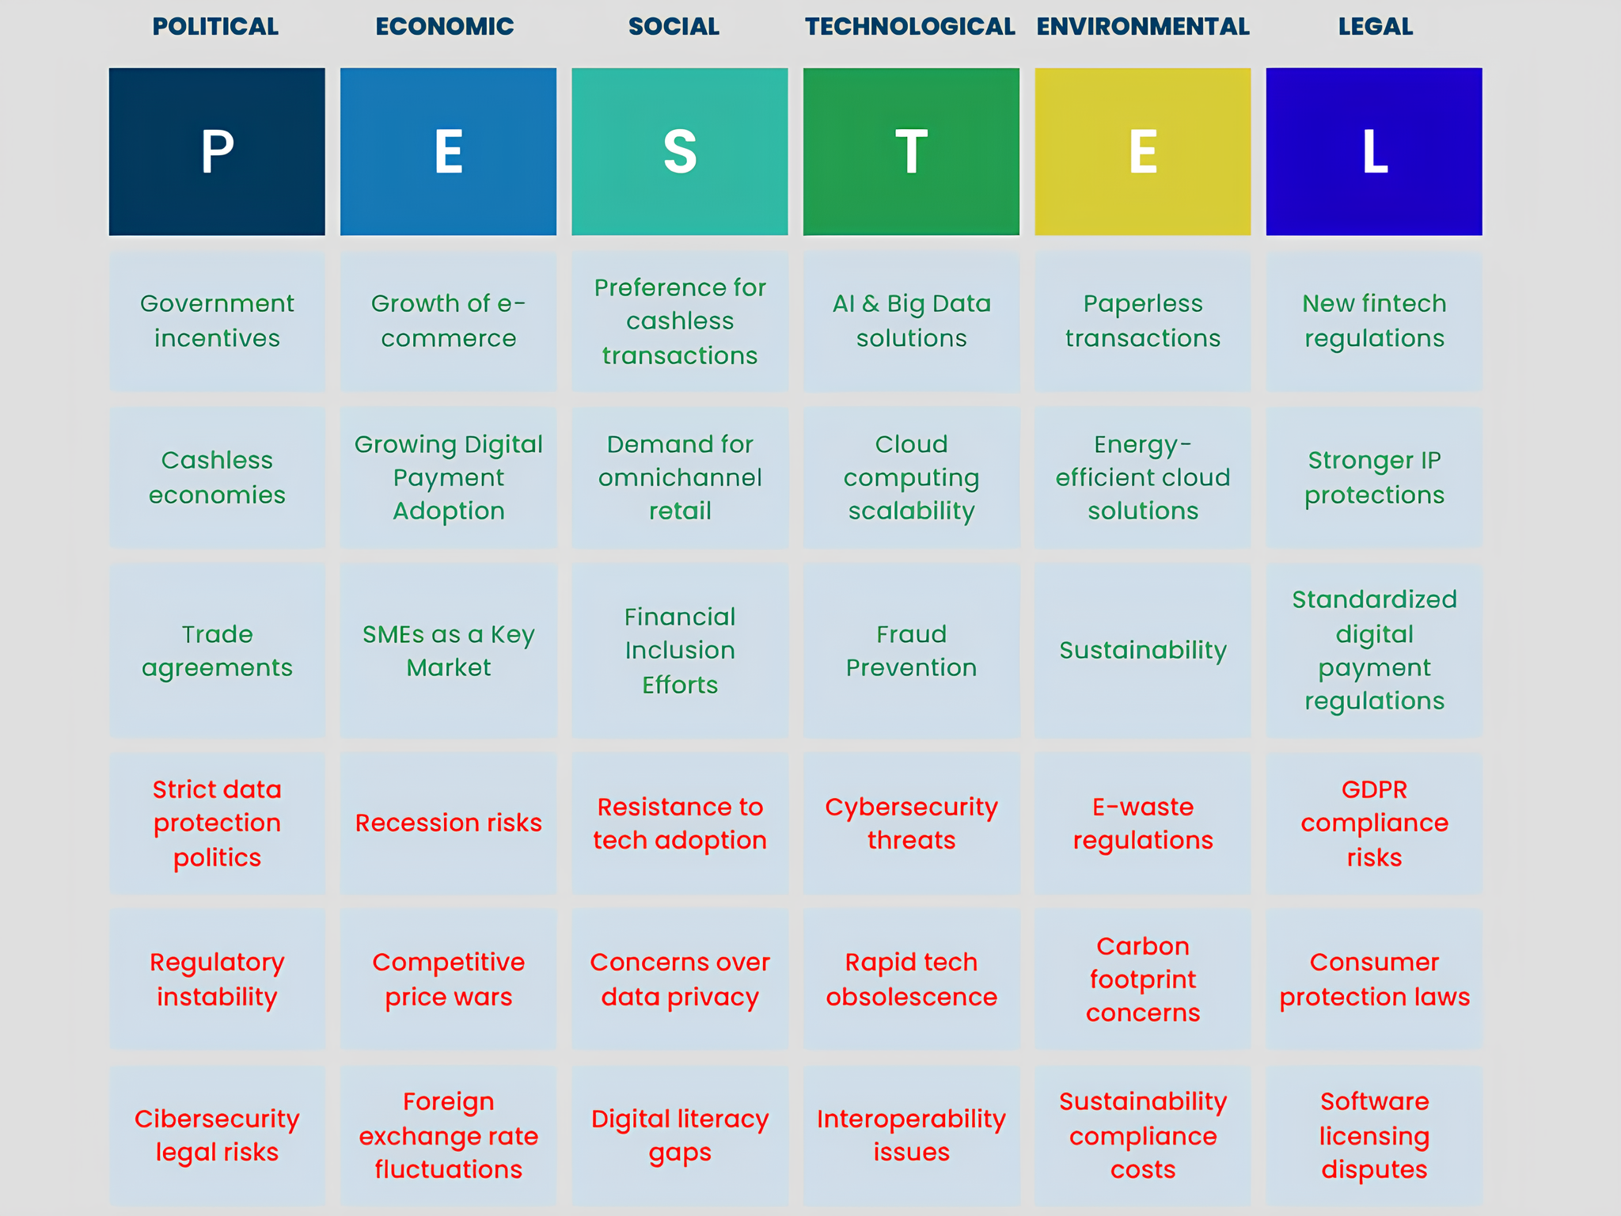
PESTEL analysis

Slide 3
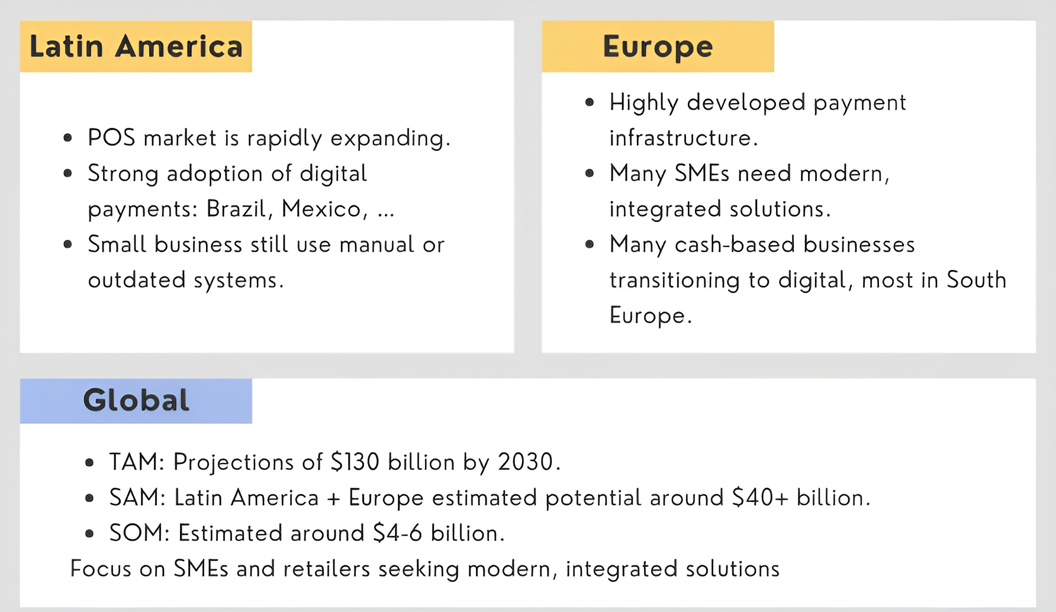
Market size

Slide 4
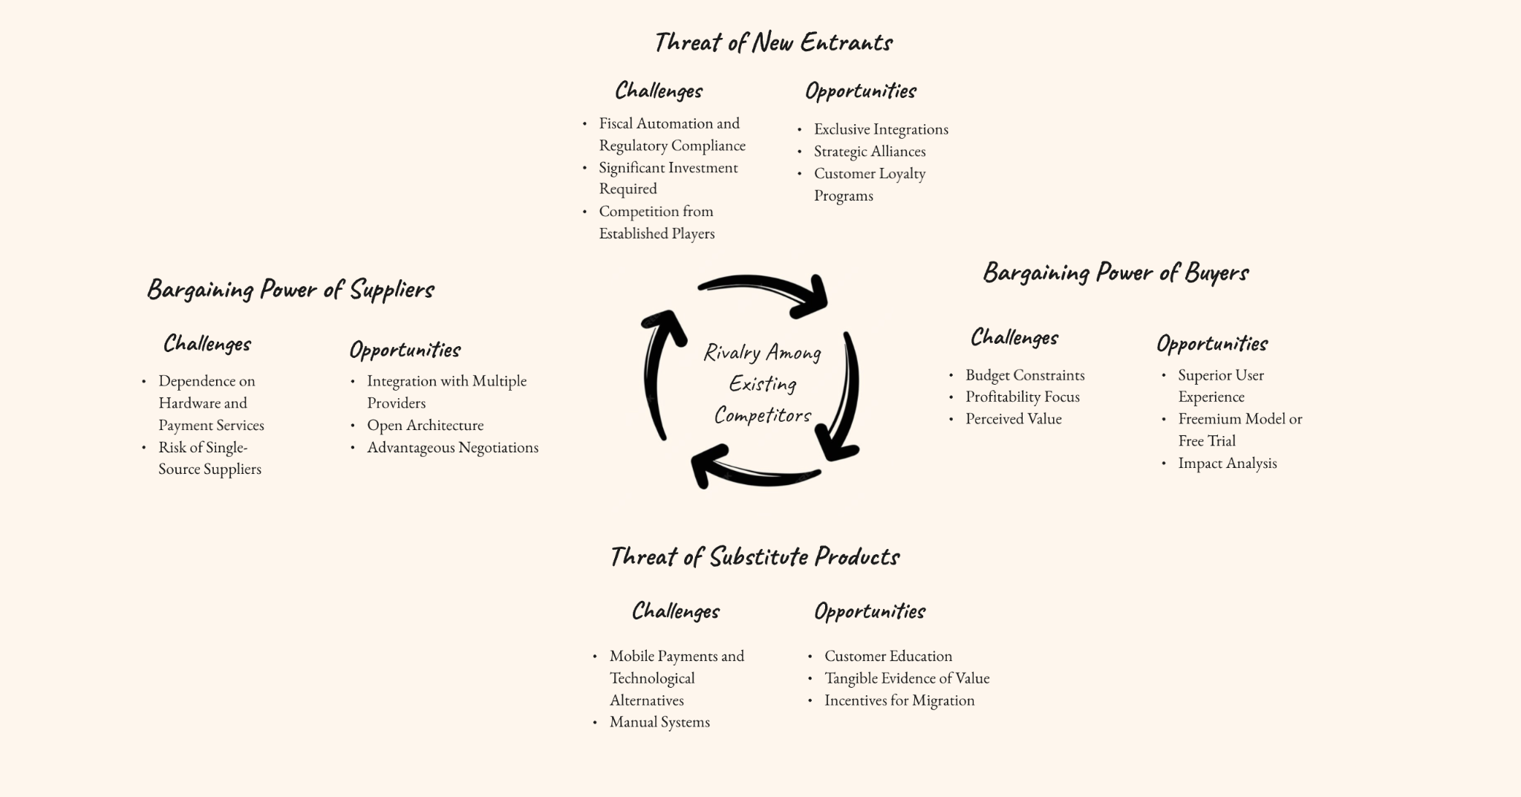
Industry competitive intensity

Slide 5
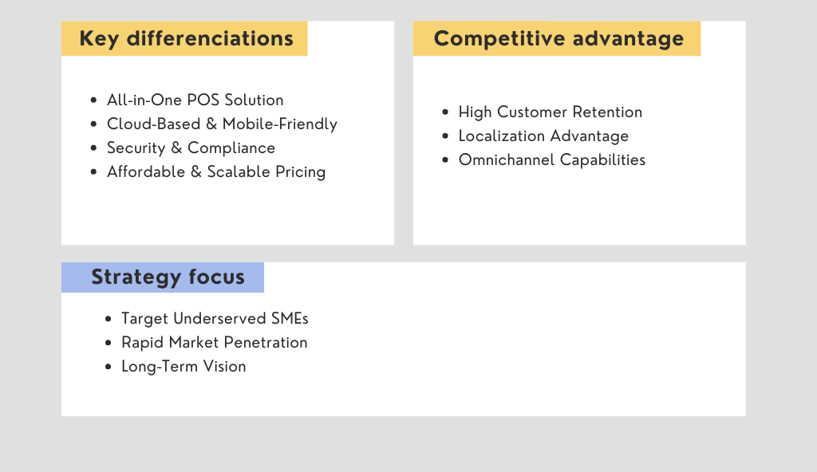
Competitive advantage

Slide 6
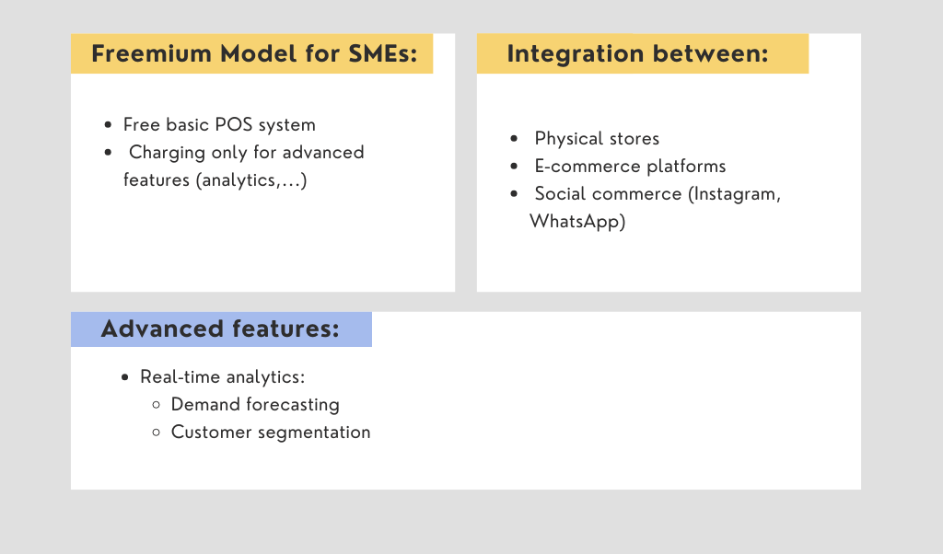
Disruption strategy

